Slide 1
Floating-point Number in IEEE 754 Format

Slide 2
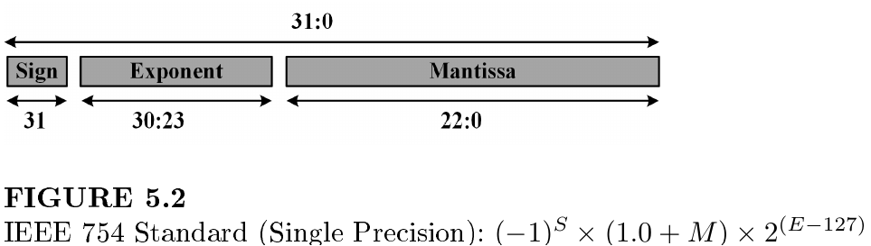
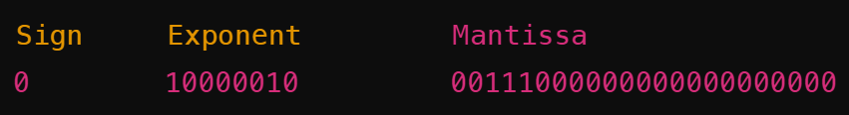
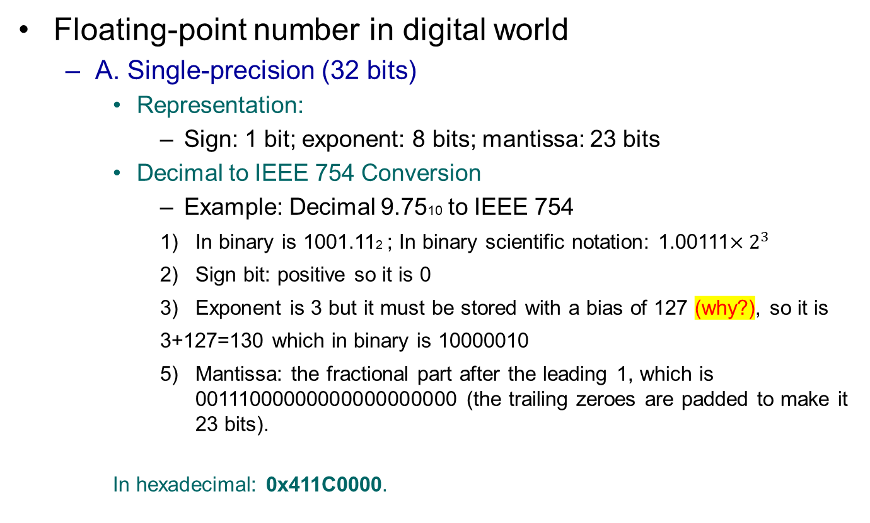
Floating-point number in digital world
Floating-point number in digital world
A. Single-precision (32 bits)
Representation:
Sign: 1 bit; exponent: 8 bits; mantissa: 23 bits
Decimal to IEEE 754 Conversion
Example: Decimal 9.7510 to IEEE 754
In binary is 1001.112 ; In binary scientific notation: 1.00111$×2^{3}$
Sign bit: positive so it is 0
Exponent is 3 but it must be stored with a bias of 127 (why?), so it is
3+127=130 which in binary is 10000010
Mantissa: the fractional part after the leading 1, which is 00111000000000000000000 (the trailing zeroes are padded to make it 23 bits).
In hexadecimal: 0x411C0000.

Slide 3

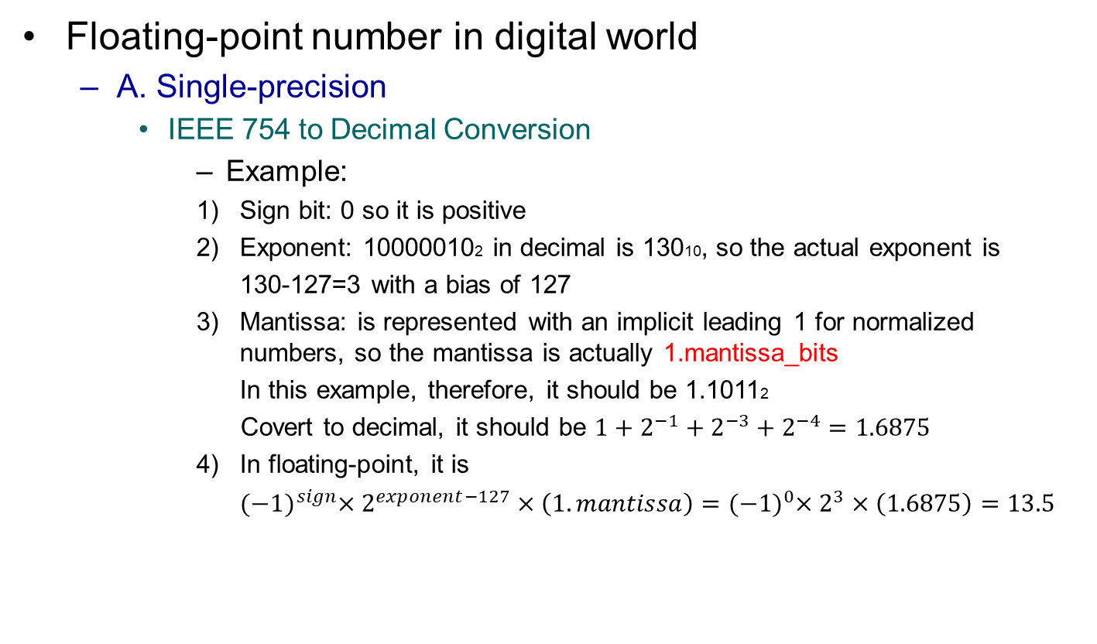
Floating-point number in digital world
Floating-point number in digital world
A. Single-precision
IEEE 754 to Decimal Conversion
Example:
Sign bit: 0 so it is positive
Exponent: 100000102 in decimal is 13010, so the actual exponent is
130-127=3 with a bias of 127
Mantissa: is represented with an implicit leading 1 for normalized numbers, so the mantissa is actually 1.mantissa_bits
In this example, therefore, it should be 1.10112
Covert to decimal, it should be $1+2^{−1}+2^{−3}+2^{−4}=1.6875$
In floating-point, it is
${(−1)}^{sign}×2^{exponent−127}×\left(1.mantissa\right)={(−1)}^{0}×2^{3}×\left(1.6875\right)=13.5$

Slide 4
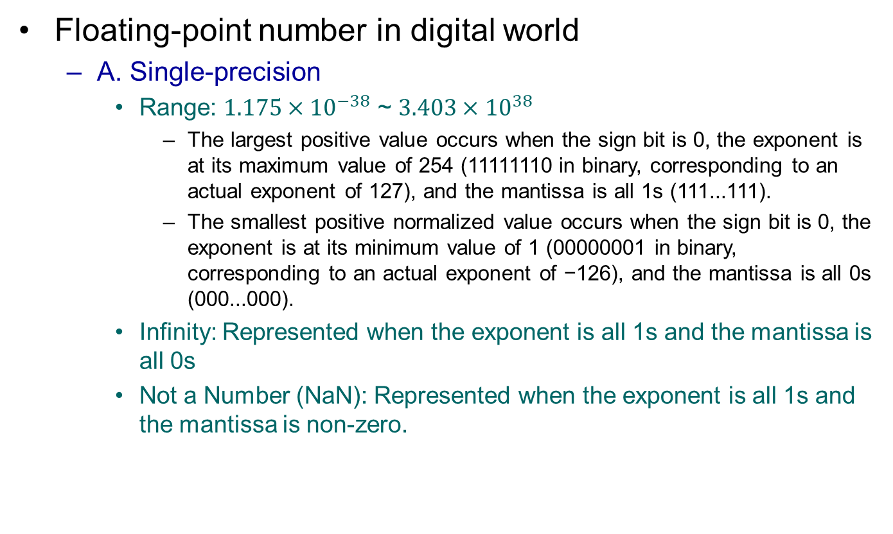
Floating-point number in digital world
Floating-point number in digital world
A. Single-precision
Range: $1.175×{10}^{−38}$ ~ $3.403×{10}^{38}$
The largest positive value occurs when the sign bit is 0, the exponent is at its maximum value of 254 (11111110 in binary, corresponding to an actual exponent of 127), and the mantissa is all 1s (111...111).
The smallest positive normalized value occurs when the sign bit is 0, the exponent is at its minimum value of 1 (00000001 in binary, corresponding to an actual exponent of −126), and the mantissa is all 0s (000...000).
Infinity: Represented when the exponent is all 1s and the mantissa is all 0s
Not a Number (NaN): Represented when the exponent is all 1s and the mantissa is non-zero.

Slide 5
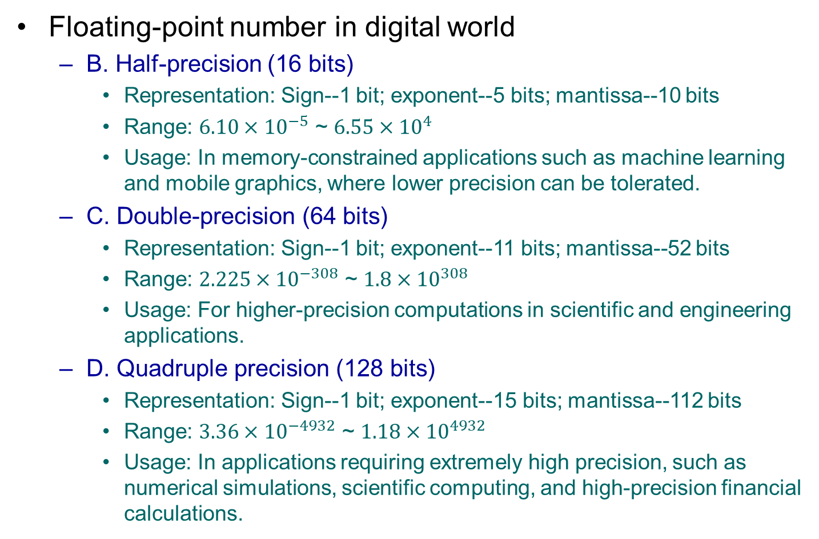
Floating-point number in digital world
Floating-point number in digital world
B. Half-precision (16 bits)
Representation: Sign--1 bit; exponent--5 bits; mantissa--10 bits
Range: $6.10×{10}^{−5}$ ~ $6.55×{10}^{4}$
Usage: In memory-constrained applications such as machine learning and mobile graphics, where lower precision can be tolerated.
C. Double-precision (64 bits)
Representation: Sign--1 bit; exponent--11 bits; mantissa--52 bits
Range: $2.225×{10}^{−308}$ ~ $1.8×{10}^{308}$
Usage: For higher-precision computations in scientific and engineering applications.
D. Quadruple precision (128 bits)
Representation: Sign--1 bit; exponent--15 bits; mantissa--112 bits
Range: $3.36×{10}^{−4932}$ ~ $1.18×{10}^{4932}$
Usage: In applications requiring extremely high precision, such as numerical simulations, scientific computing, and high-precision financial calculations.

Slide 6
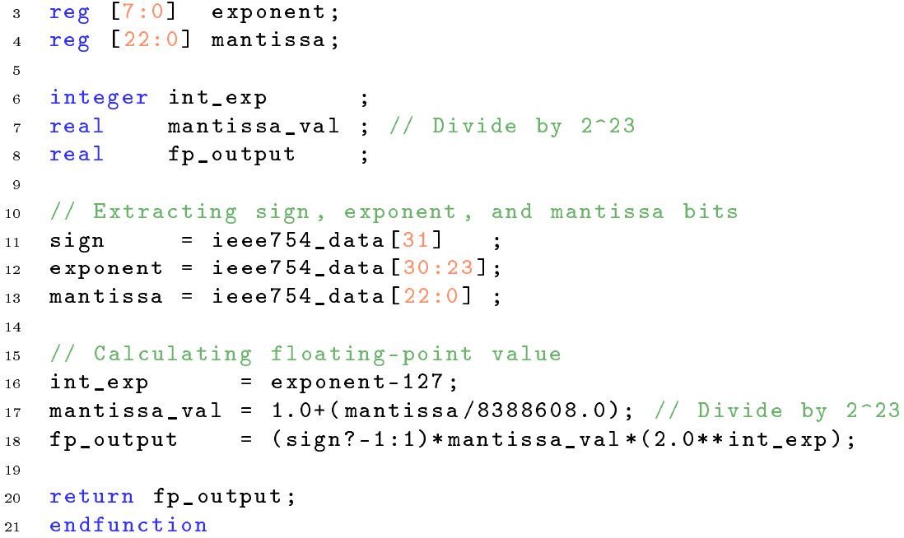
SV Function
SV Functions
IEEE 754 to SP Conversion

Slide 7
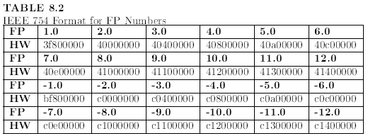
IEEE 754 Table
IEEE 754 V.S SP Number

